Slide 1
Project #3
ANN and Deep Learning
Geri Dimas, Charles Parsons, Satishraju Rajendran

Slide 2
The Basics:
6500 image data points:
Reshape the image data into 28*28 per image,
Convert labels into one-hot encodings (0-9)
Sampling:
60% Training
15% Validation
25% Testing
Normalized Data
Used 5-fold cross validation for measuring performance of model

Slide 3
Experiments: Impact of Normalization of Data
Exper. | # layers (# nodes per layer) | Activation (Kernel Initializer) | # Epochs | BatchSize | *Train_Loss | *Train_acc | *Val_Loss | *Val_Acc
A | 3 | he_normal | 10 | 512 | 2.151 | 0.19 | 2.171 | 0.193
 | A1-10 N A2-10 N A3-10 N | A1-A2:(relu) A3:(softmax)
A_nor | “” | “” | “” | “” | 2.1794 | 0.18706 | 2.173 | 0.1963

Slide 4
Experiments: Impact of Node size increase
A_nor | “” | “” | “” | “” | 2.1794 | 0.18706 | 2.173 | 0.1963
B_nor | 3 | he_normal | 10 | 512 | 1.9238 | 0.504 | 1.9001 | 0.519
 | B1-100 N B2-100 N B3-10 N | B1-B2:(relu) B3:(softmax)

Slide 5
Experiments: Impact of change of Activation Function
B_nor | 3 | he_normal | 10 | 512 | 1.9238 | 0.504 | 1.9001 | 0.519
 | B1-100 N B2-100 N B3-10 N | B1-B2:(relu) B3:(softmax)
C_nor | 3 | he_normal | 10 | 512 | 0.8862 | 0.78641 | 0.8715 | 0.7871
 | C1-100 N C2- 100 N C3- 10 N | C1-C2:(selu) C3:(softmax)

Slide 6
Experiments: Change in Batch Sizes
C_nor | 3 | he_normal | 10 | 512 | 0.8862 | 0.78641 | 0.8715 | 0.7871
 | C1-100 N C2- 100 N C3- 10 N | C1-C2:(selu) C3:(softmax)
E_nor | 3 | he_normal | 10 | 80 | 0.3631 | 0.90313 | 0.39603 | 0.89066

Slide 7
Experiments: Change in Epochs
E_nor | 3 | he_normal | 10 | 80 | 0.3631 | 0.90313 | 0.39603 | 0.89066
 | E1-100 N E2-100 N E3-10 N | E1-E2:(selu) E3:(softmax)
F_nor | 3 | he_normal | 20 | 80 | 0.2701 | 0.92795 | 0.3338 | 0.904
 | F1-100 N F2- 100 N F3- 10N | F1-F2:(selu) F3:(softmax)

Slide 8
Experiments: Best Model
Normalized the Data
3 layers; Input, 1 hidden layer, output layer
Activation function for input and hidden layer: selu
Number of nodes for input and hidden layer : 100
Batch- Size: 80
Epochs: 20
Val Loss: 0.3338
Val Accuracy: 0.904
F_nor | 3 | he_normal | 20 | 80 | 0.2701 | 0.92795 | 0.3338 | 0.904
 | F1-100 N F2- 100 N F3- 10N | F1-F2:(selu) F3:(softmax)

Slide 9
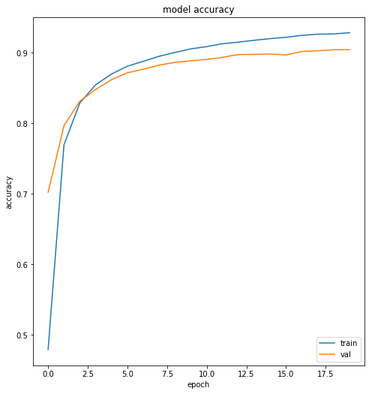
Best Model Performance

Slide 10
Best Model Performance
precision recall f1-score support 0 0.93 0.97 0.95 163 1 0.92 0.98 0.95 182 2 0.91 0.86 0.88 159 3 0.88 0.88 0.88 167 4 0.90 0.90 0.90 164 5 0.91 0.89 0.90 142 6 0.92 0.91 0.92 166 7 0.91 0.90 0.90 171 8 0.86 0.85 0.86 150 9 0.86 0.87 0.86 161 weighted avg : 0.90 0.90 0.90 1625
[[158 0 0 1 0 1 1 0 2 0] [ 0 178 0 0 0 1 1 0 1 1] [ 2 1 136 5 3 0 2 1 7 2] [ 1 2 4 147 0 4 0 4 3 2] [ 1 1 1 0 147 1 5 1 0 7] [ 0 0 1 6 2 126 2 0 4 1] [ 1 2 4 0 1 3 151 1 3 0] [ 2 4 1 0 4 0 0 154 0 6] [ 1 4 3 5 1 2 1 2 127 4] [ 4 1 0 3 5 0 1 7 0 140]]

Slide 11
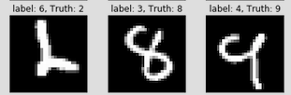
Best Model Performance: Misclassification Example

Slide 12
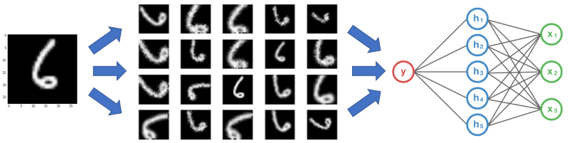
Advanced Topic: Data Augmentation
Basics of Data Augmentation:
Image soruce: https://medium.com/nanonets/how-to-use-deep-learning-when-you-have-limited-data-part-2-data-augmentation-c26971dc8ced
Notes:
Can be applied as a pre-processing step, transforming images BEFORE building the model ( Called Offline augmentation) OR Can also be applied in each mini-batch prior to “feeding” the images into the model ( called online augmentation)

Slide 13
Advanced Topic: Data Augmentation
Generative Adversarial Network (GAN)
Generative vs. Discriminative Algorithms
Descrimative: Try to predict LABELS given a set of features
Generative: Opposite; Try to predict FEATURES given a label
Descrimative care about relationship between y and x -- difference between class label groups
Generative algorithms care more about HOW you get x-- difference within class label groups

Slide 14
GAN: The Process
“Counterfeiter”
Generator
Convolution NN
“Nosie”
Samples
“A Cop”
Probability ( 0-1)
Discriminator
Inverse convolution NN
REAL
FAKE
Training Set
Samples
Notes:
Both the Generator NN and the Discriminator NN are convolution networks, just the Discriminator on is an Inverse convolution network

